Slide 1
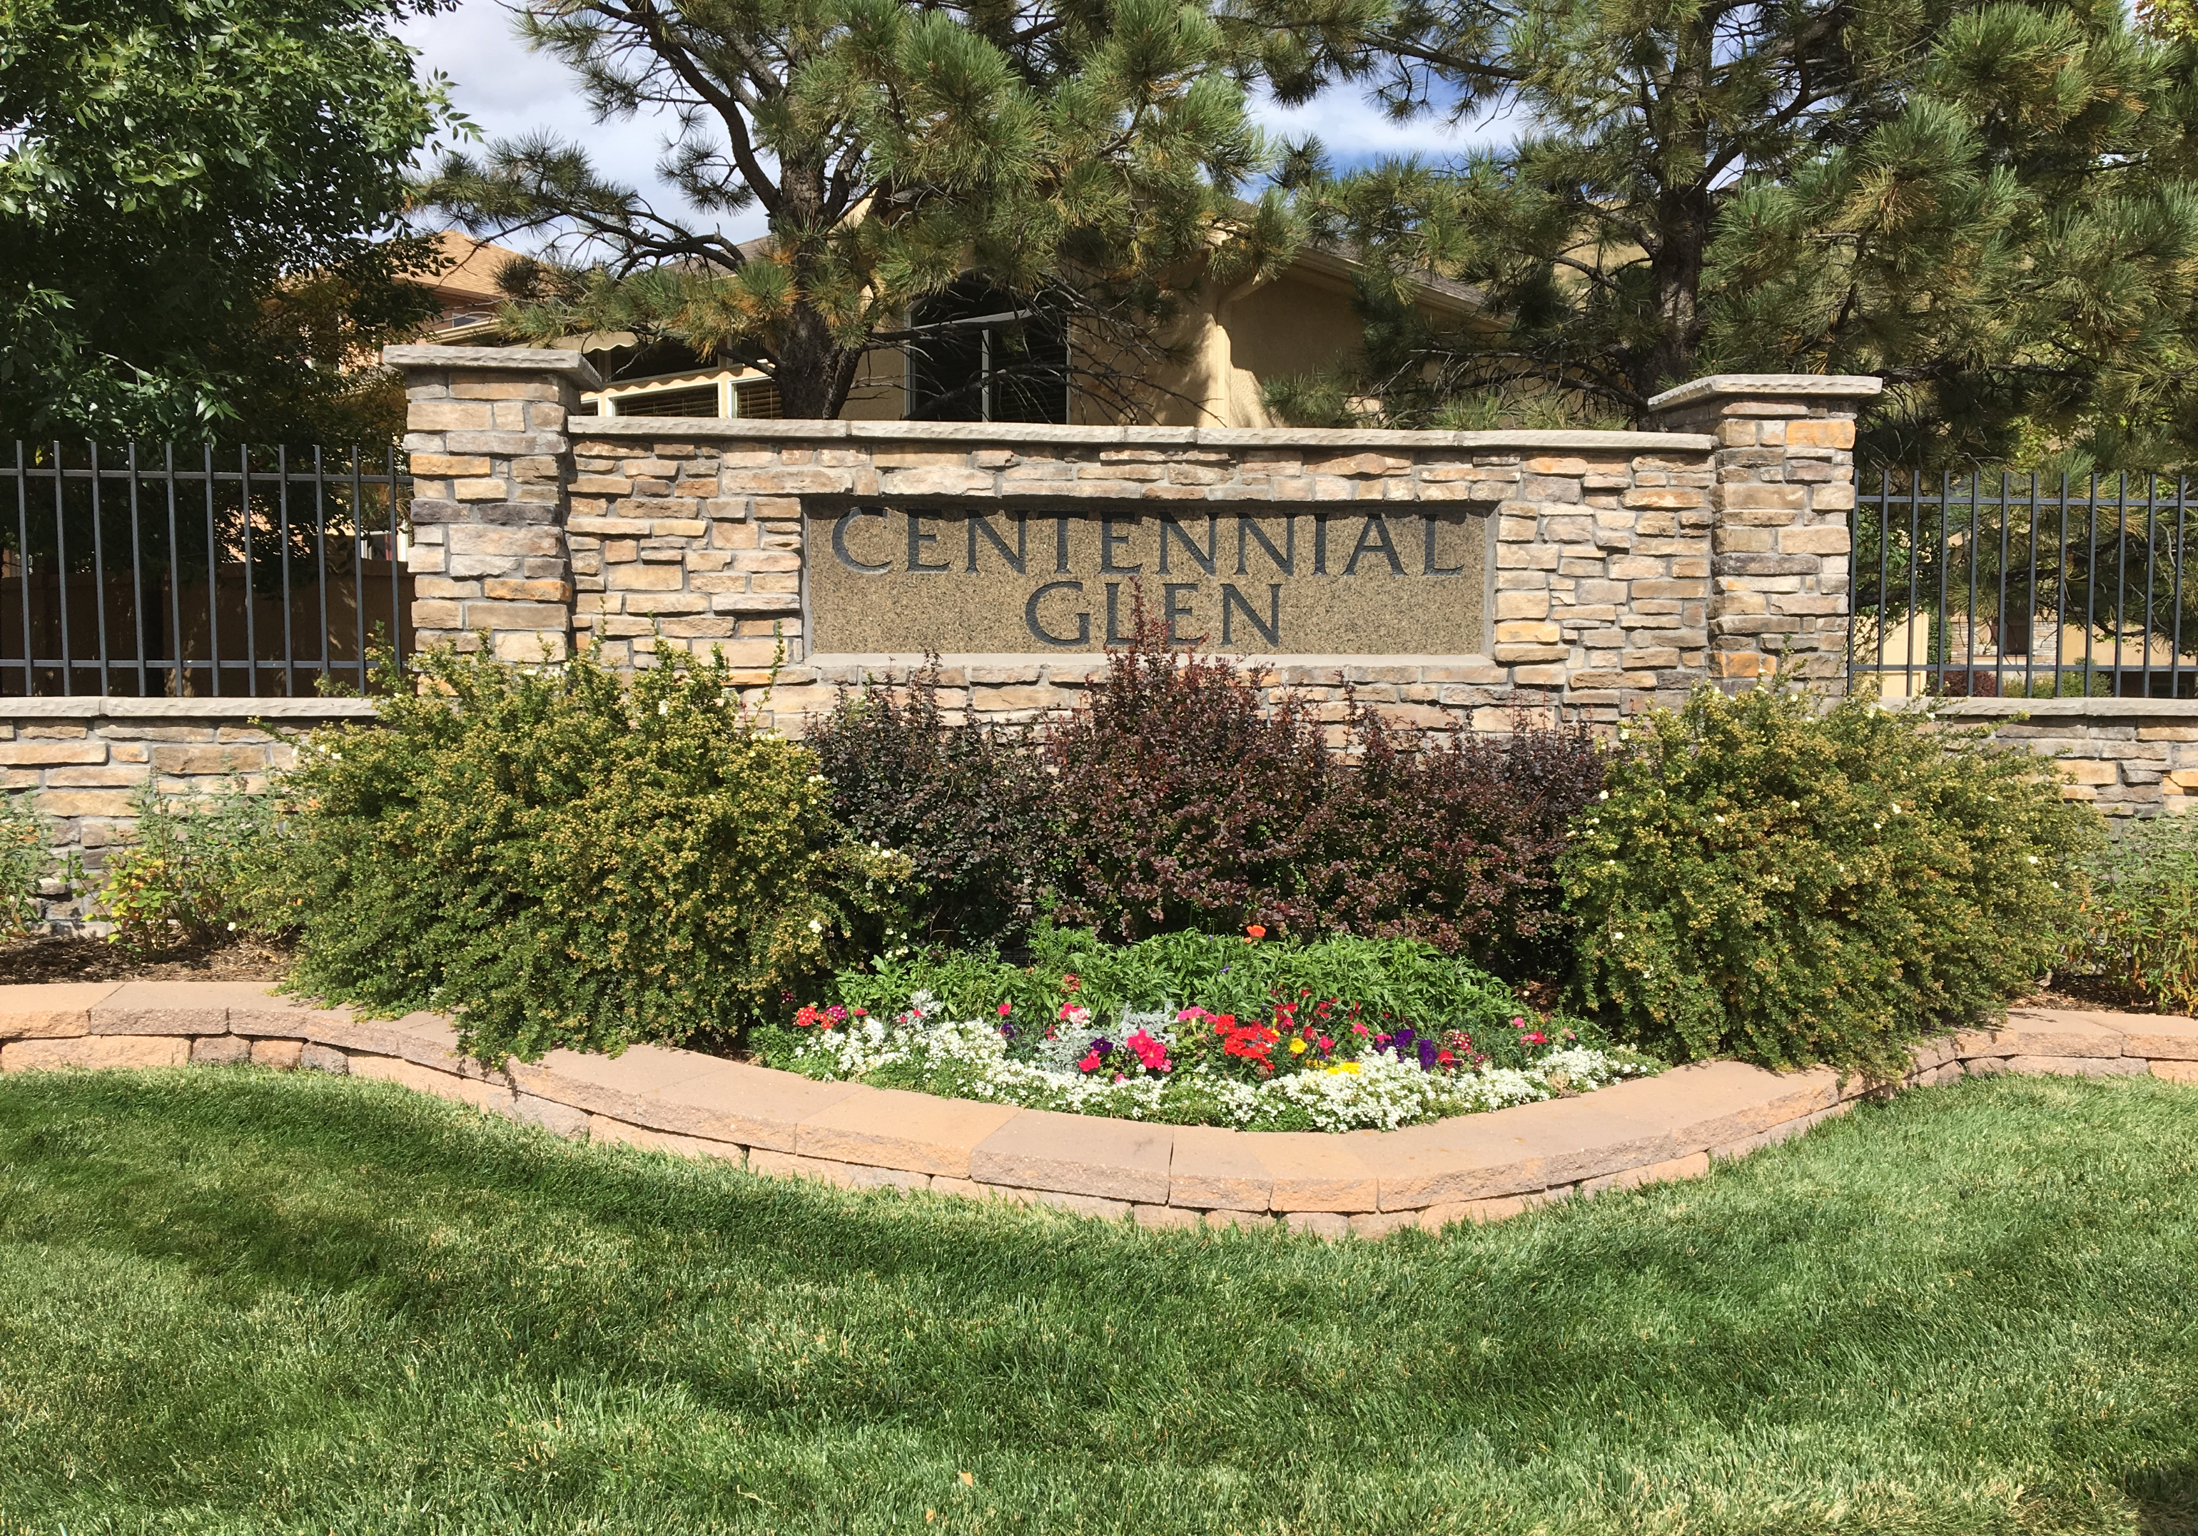

Slide 2
CENTENNIAL GLEN HOA
2025
ANNUAL MEETING
November 19, 2025

Slide 3
Agenda
Determination of Quorum - 2 minutes
Election of 2026 Board of Directors – 5 minutes
Proof of Notice of Meeting – 1 minute
Approval of 2024 Annual Meeting Minutes – 2 minutes
Owner Education – 2025 Legislation – 5 minutes
Board Reports - 30 minutes
  Architectural Committee Report
  2025 Accomplishments
  Capital Reserve Funding
  2025 Financial Results
  2026 Goals/Projects
  2026 Budget/ Establish Annual Dues
Election results – 5 minutes
Other/Q&A – 5 minutes
Adjournment – 5 minutes

Slide 4
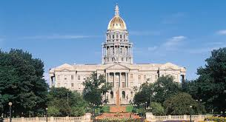
Owner Education – Legislation Updates

Slide 5
Colorado – State Legislation
House Bill 25-1043
  Revised various sections of CCIOA (Colorado Common Interest Ownership Act) with respect to the collection and foreclosure of delinquent assessments.
  Board adopted new Collection Policy to be in compliance
  Policy available on the website:
    Documents and Forms tab: Resolution 2025-9 Collection of Unpaid Assessments

Slide 6

Architectural Committee Report

Slide 7
2025 Accomplishments
Continued efforts to remain transparent and keep homeowners informed
Encouraged homeowners to perform upkeep and maintenance on homes
Saved approximately $500 by disconnecting water service during winter
Complied with all changes required by new legislation
Completed routine compliance requirements – Tax returns, HOA record retention, Annual registrations, Insurance renewals and Reserve transfer
Completed commons area rock project
Successfully transitioned new Board members into roles

Slide 8

2025 Financial Results

Slide 9
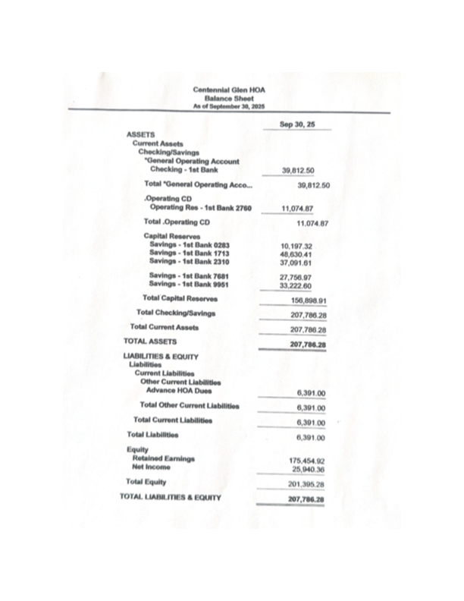
Balance Sheet – Through September 2025

Slide 10
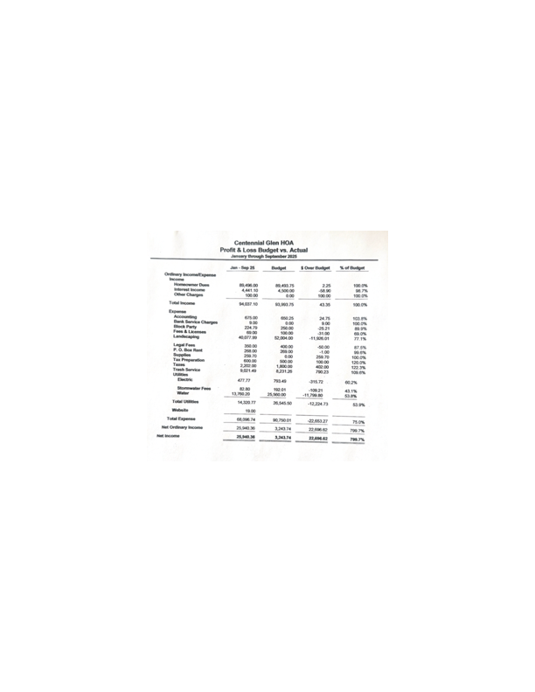

Slide 11
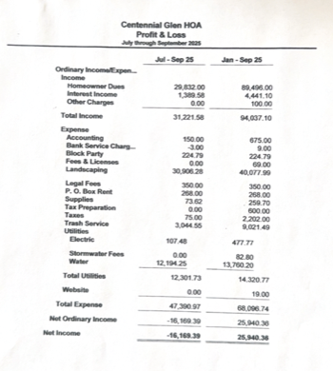

Slide 12
2025
Goals and
Projects
  Enlist HOA member participation in on-going HOA projects
  Be good stewards of HOA funds
  Maintain transparency with homeowners
  Emphasize Architectural compliance
  Continue to upgrade Common Areas and maintain and repair entrance sign
  Comply with regulatory requirements
  Host a charity event
  Make adequate Capital Reserve Contribution
  Continue Board education
  Comply with HOA record retention policies
  Hold four social events throughout the year

Slide 13
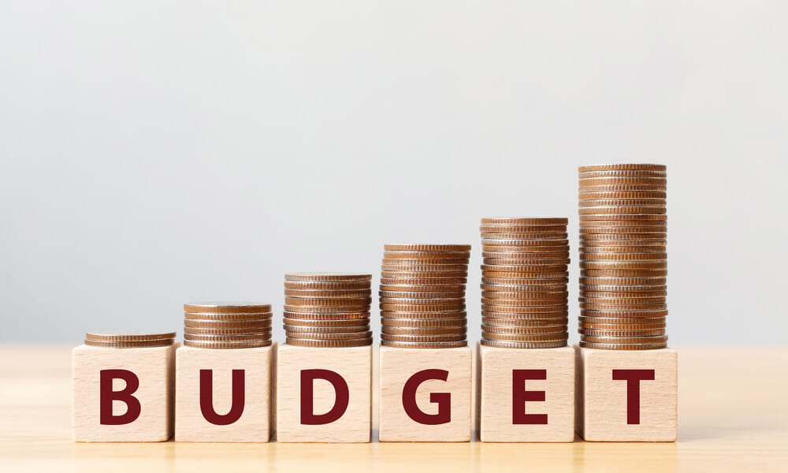
2026 Budget & Dues

Slide 14
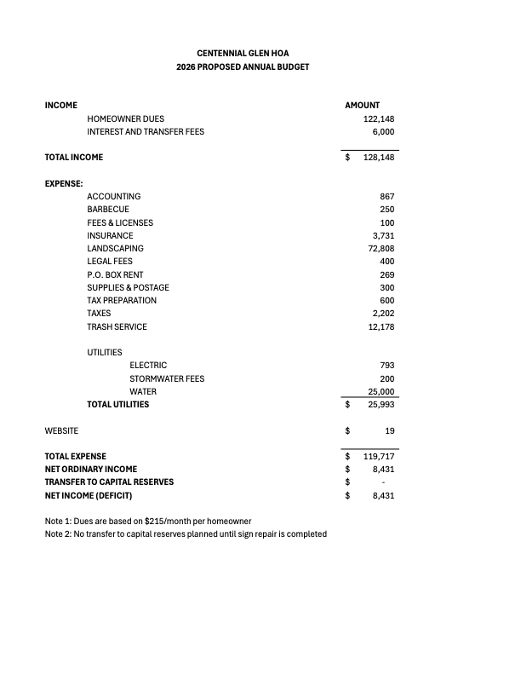

Slide 15
2026
Monthly
Dues
2026 Monthly dues will remain at $215
Dues are required to be paid on the 1st of each month

Slide 16
Other Items
Covenants – Reminders
  Exterior maintenance on houses – exterior of homes need to maintained in good condition – includes exterior surfaces, decks, walks and driveways
  Trash receptacles – Only allowed out on trash day
    Neighbors can contact trash company directly for any concerns
  Garage door reminder - for security purposes they should not be left open for extended period of times
  Gardening tools, bags of fertilizer/top-soil/recreational items (canoes, soccer goals, etc.) need to be stored inside when not in use
  Air BNB’s are not permitted
Any changes to the exterior of your house or yard require approval of the Architectural Committee prior to work completed- request form on website
Please water on warm winter days
Any questions
Adjournment

